Slide 1
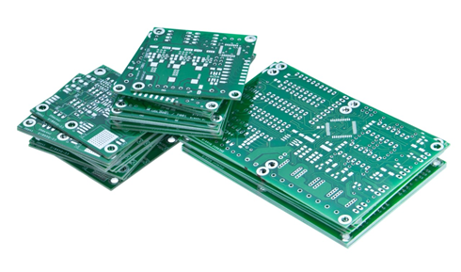
Project Based Learning
Holistic Development :Outcome Based Education
for A. Y.2021-22
Final presentation DATE: 06/10/2021

Slide 2
Guidelines for Students
State /Identify the Problem for the implementation in consultation with your faculty member
Generate the idea to solve the problem with technical solution
Identify the Learning issues related to it
Emphasis on Self directed Learning through literature survey
Suggest the technical / Practical Implementable feasible Solution
Identify the team members and Build the team
Evaluate the theoretical results and surveys if any
Identify the Design ,Synthesis and application
Present the results
Emphasis on Reflection of results, development experience, challenges and feedback in informative way and documentation.
Co relate the overall learning experience and future scope
GA6
GA5
GA3
GA1
GA10
GA8
GA11
GA7
GA2
GA9
GA12

Slide 3
Title of the Project
Automatic Irrigation system using IOT
Prepared by :
TE E&TC B
Vamshi Vemula (54)
Shlok sharma (33)
Ashmit Singh (38)
Under the guidance of:
Mr. Deepak Shete

Slide 4
Contents
Title of the Project
TV 2035 track
Technical Solution
Abstract
Proposed Methodology/ Algorithm
Future Lens
User Lens
Organizational lens
Outcome

Slide 5
Problem Identification
Agriculture is the backbone of Indian Economy. In today’s world, as we see rapid growth in global population, agriculture becomes more important to meet the needs of the human race.
However, agriculture requires irrigation and with every year we have more water consumption than rainfall, it becomes critical for growers to find ways to conserve water while still achieving the highest yield.
According to statistics, agriculture uses 85% of available freshwater resources worldwide, and this percentage will continue to be dominant in water consumption because of population growth and increased food demand.
So to curb this problem, farmers have been introduced to a new, technical and innovative source of agricultural irrigation which is irrigation using Internet of things(IOT). By using Internet technology and sensor network technology we can control water wastage and greatly improve the utilization of water thereby increasing the crops productivity.

Slide 6
Technical Solution
This System Saves the lot of Time, Energy and resources of the Farmers.
This System Automatically controls the water level in the soil.
The Data can be remotely monitored using the Thingspeak Websites.
In Thingspeak we can analyse the overall data.
If farm get wild fire then it can be alerted to take quick actions.

Slide 7
Application of your project
The main application of this project is to provide an automatic irrigation system thereby saving time, money & power of the farmer.
The traditional farm-land irrigation techniques require manual intervention. With the automated technology of irrigation, the human intervention can be minimized.
The proposed agricultural system is designed to solve to find an optimal solution to the water crisis.
The design implements IoT technology using an android device, a main controlling unit (MCU), sensors to measure various parameters and a water pump, which will be used to supply water to the farm.

Slide 8
Abstract
Agriculture is the most important occupation for the most of the Indian families. It plays a vital role in India’s economy.
Water is main resource for Agriculture. Irrigation is one method to supply water but in some cases there will be lot of water wastage.
So, in this regard to save water and time we have proposed project titled automatic irrigation system using IoT.
In this proposed system we are using various sensors like temperature, gas, soil moisture sensors which senses the various parameters of the soil and based on soil moisture value land gets automatically irrigated by ON/OFF of the motor.
These sensed parameters and motor status will be displayed on a website.

Slide 9
Development Experience
We have gained an insight into the working of an automated IOT project.
Our understanding of sensors and circuits designing has been strengthened as well.
We learnt the incredibly profound abilities of Arduino Ide, and we were able to explore a development of options that Thingspeak provides.
We were able to understand how overall all the sensors and circuit connections work, with different behaviours associated to each object in every level.

Slide 10
Learning issue faced by the team
We had our basics of C language and Arduino Ide software cleared through the ESD and PS program in this semester and the previous semester, but we faced a problem when we started with the advanced concepts, for which we had to go through tutorials which consumed some time.
Designing the entire automated system was a rather tedious task, as there were many components to be placed and a lot of code to be done.

Slide 11
User Lens
The proposed agricultural system is designed to solve to find an optimal solution to the water crisis.
This automated approach will detect the moisture level in the soil thereby ensuring that there is no excess of water wastage in the farm.
It also ensurses that the required light is provided or not. If not then it automatically turns on the Artificial light. To perform proper Photosynthesis.
This System also detects the smoke level in Atmosphere. If any smoke is sensed in Atmosphere it alarm makes the alert.

Slide 12
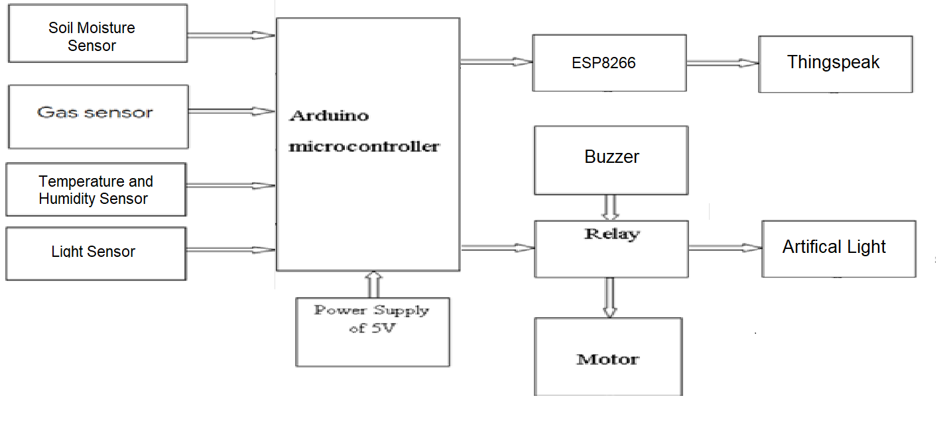
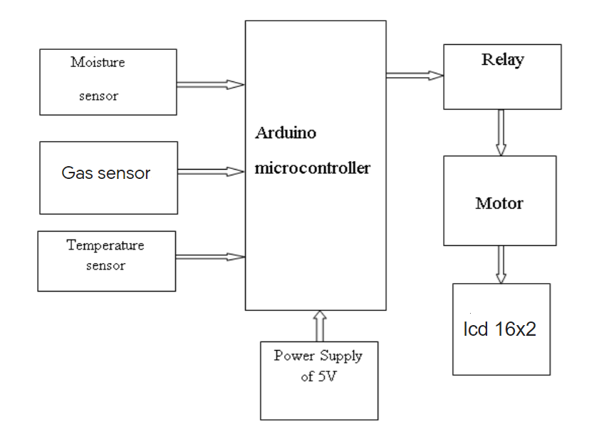
Proposed Methodology/ Flowchart

Slide 13
Proposed Methodology/Algorithm
The flowchart is a overall block diagram of Arduino based automatic irrigation system which consist of four sensors which are connected to controller and sensed values from these sensors are displayed on a thingspeak.
This project has wireless sensor network for real-time sensing of an irrigation system. This system provides uniform and required level of water for the Automation of irrigation system using IoT.
When the moisture level in the soil reaches below threshold value then system automatically switch ON the motor.
When the water level reaches normal level the motor automatically switch OFF. The sensed parameters and current status of the motor will be displayed on Thingspeak Website.

Slide 14
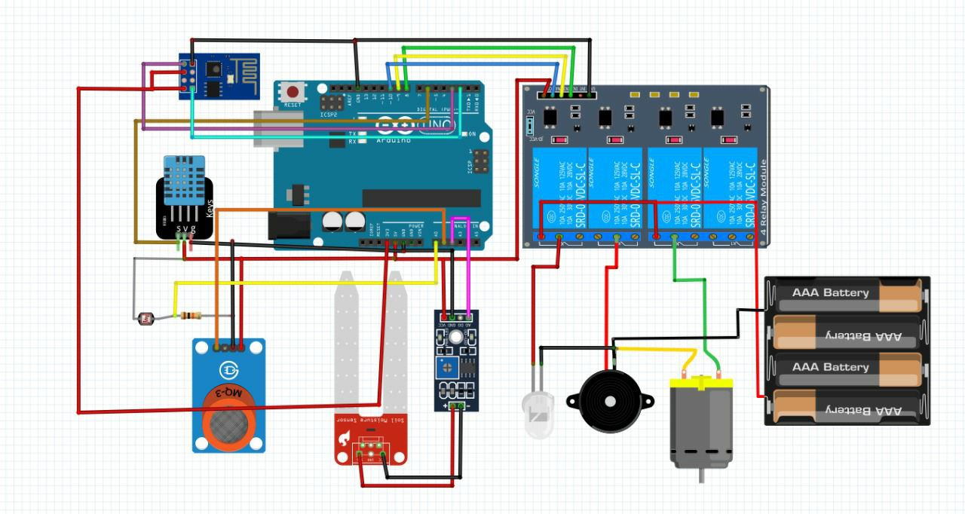
Result Presentation
Build the team and team efforts
Proposed circuit for automated irrigation system

Slide 15
Learning From the Project
We have gained an insight into the working of our project and how the overall circuit designing/code of the system works.
Our understanding of the circuit design has been strengthened .
Scheduling a project and adhering to that schedule creates a strong sense of time management.
Sense of teamwork has developed and confidence of handling real life project has increased to a great extent.
Initially, there were problem with some connections but with discussions, we were to implement them successfully.

Slide 16
Future Lens
After building the agricultural water irrigation system hardware and analysing, actually applying the internet of things to the highly effective and safe agricultural production has a significant impact on ensuring the efficient use of water resources as well as ensuring the efficiency and stability of the agricultural production.
With more advancement in the field of IoT expected in the coming years, these systems can be more efficient, much faster and less costlier.
In the Future, this system can be made as an intelligent system, where in the system predicts user actions, rainfall pattern, time to harvest, animal intruder in the field and communicating the information through advanced technology.

Slide 17
THANK YOU!
Any questions?

